Slide 1
ANN for Concrete Strength prediction

Slide 2
Gradually Increasing Ratio of Training Set
Keeping 20% of entire dataset as testing set
Gradually increasing ratio of training set from 4%to 80% of entire dataset
Testing set |  | Training set
20%
4% - 80%

Slide 3
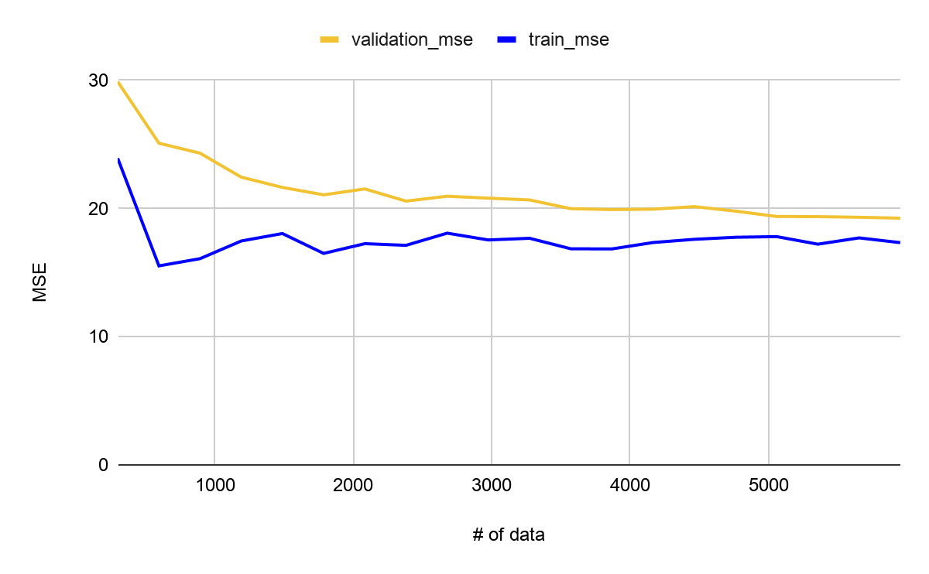
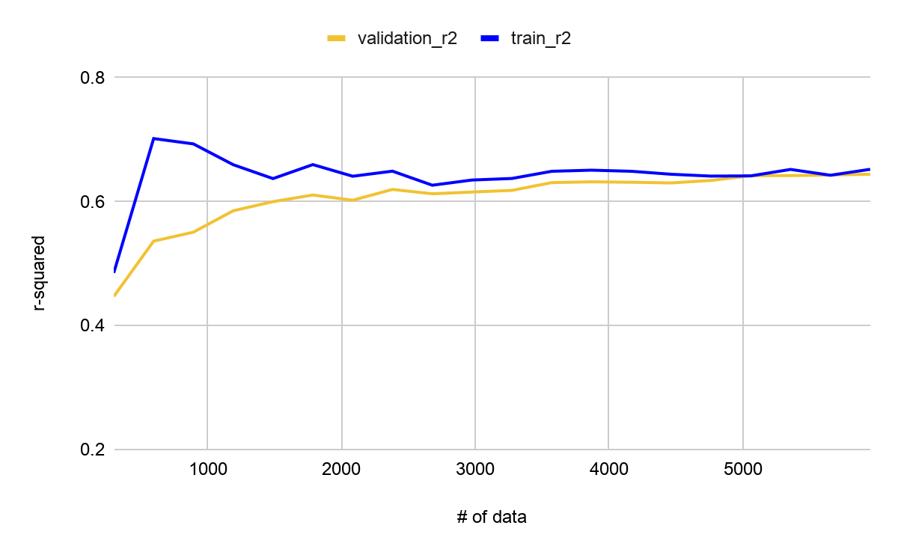
Gradually Increasing Ratio of Training Set

Slide 4
Different Algorithms as optimizers
Algorithms | r-squared | rmse
adadelta | -0.2985 | 8.101
adagrad | 0.5895 | 4.5595
adam | 0.6161 | 4.4101
ftrl | -0.0003 | 7.121
nadam | 0.6198 | 4.389
rmsprop | 0.6166 | 4.4079
sgd | 0.6141 | 4.4224
Notes:
Try different activation function

Slide 5
ANN model for concrete strength prediction
Input
Output
Number of Layers: 4
Number of neurons on each layer : 32
Activation Function : hyperbolic tangent

